Slide 1
OPERATION ECCLESIA

Slide 2
Revelation received on 19.8.2013
Vision: I woke up in the early morning hearing a voice. . “Lift up your (self name) voice that the blood will not be required at your hand.”
“இரத்தப்பழி உன்மேல் விழாதபடி உரக்க கூவி அறிவி”.
Restoration of the Church of Jesus Christ Acts 2:42-47

Slide 3
Immediate Action to be taken
Knowing all 2.3 Billion Believers about OPERATION ECCLESIA
Starting Gift schools
Making all believers house as Churches
If the Church accepts and follow the above three steps immediately before 2013 I will not give my Church to the gentiles to bring reformation in my Church.
Or else I have opened my armory and brought out the weapons of his wrath, for the Lord GOD of hosts has a work to do in the land of the Chaldeans. Jer 50:25 .

Slide 4
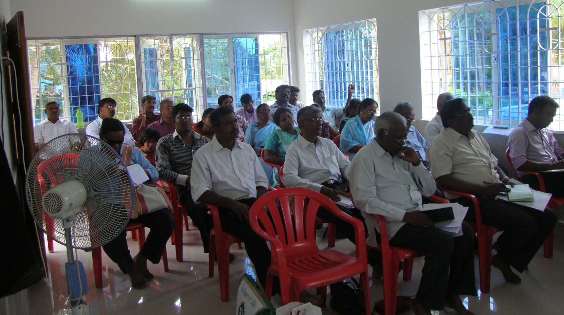
O.E – Vellore (Sep 20 – 21)

Slide 5
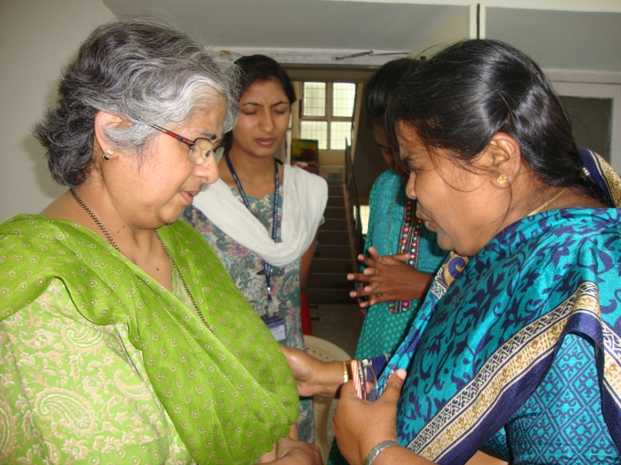
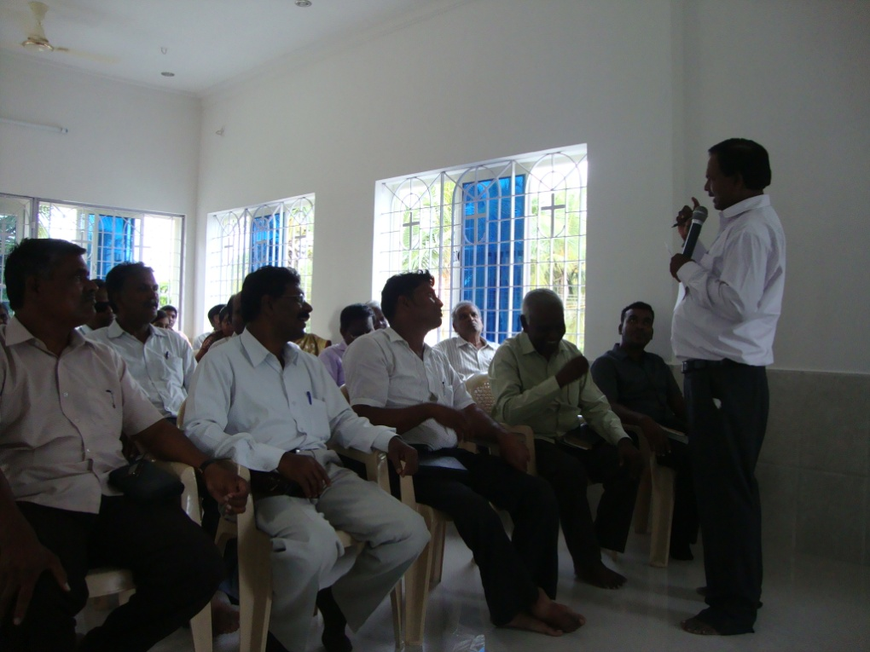
Gift Training – Vellore (Sep 28, 29)

Slide 6
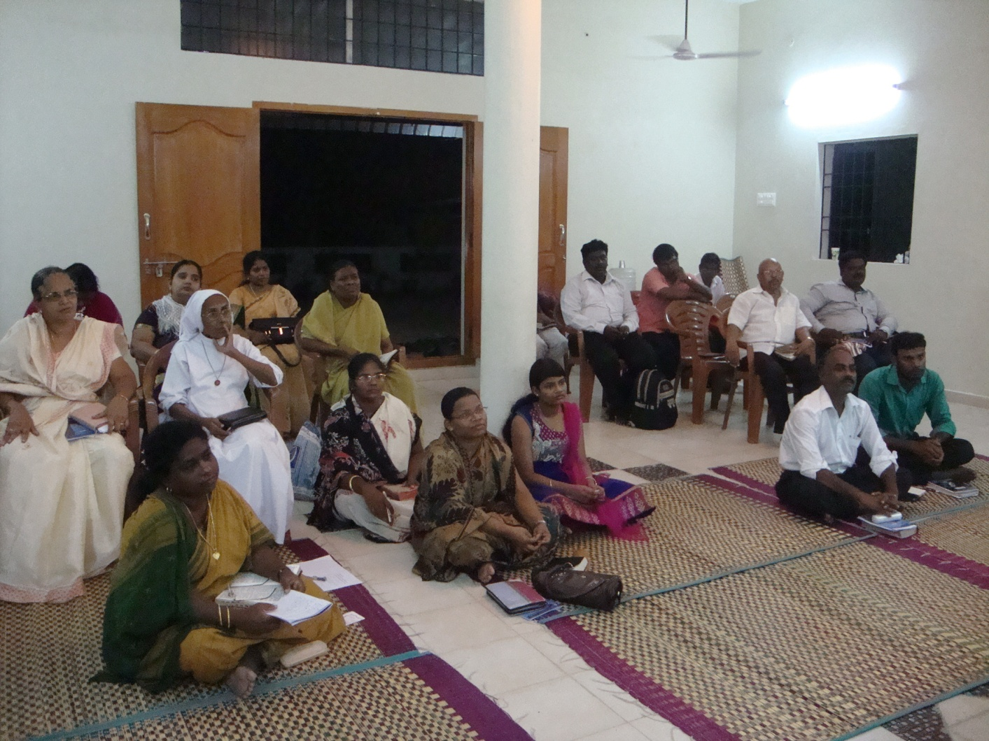
O.E & APT – Tambaram (Sep 24 – 27)

Slide 7
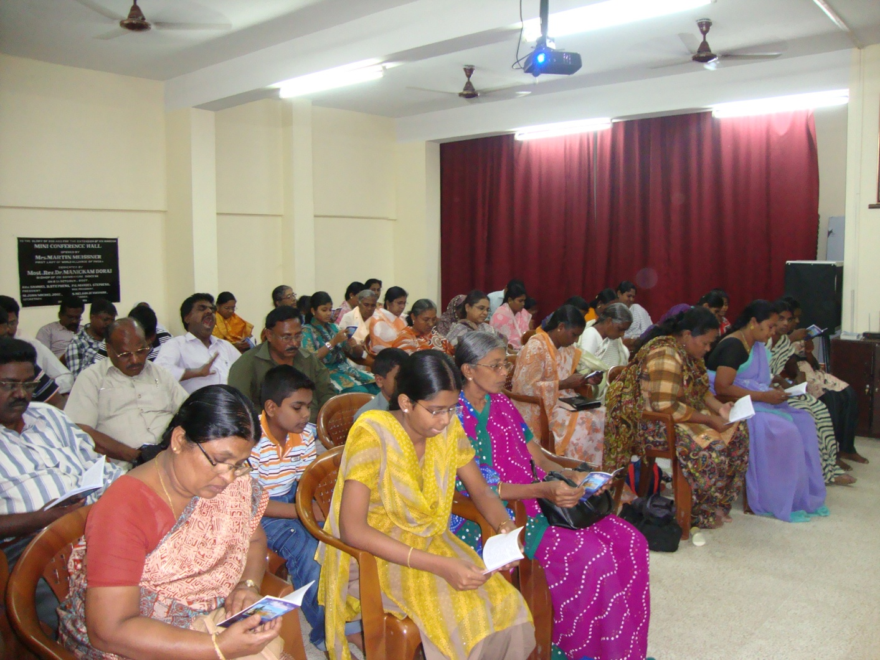
O.E– Salem (Oct 4 2013)

Slide 8
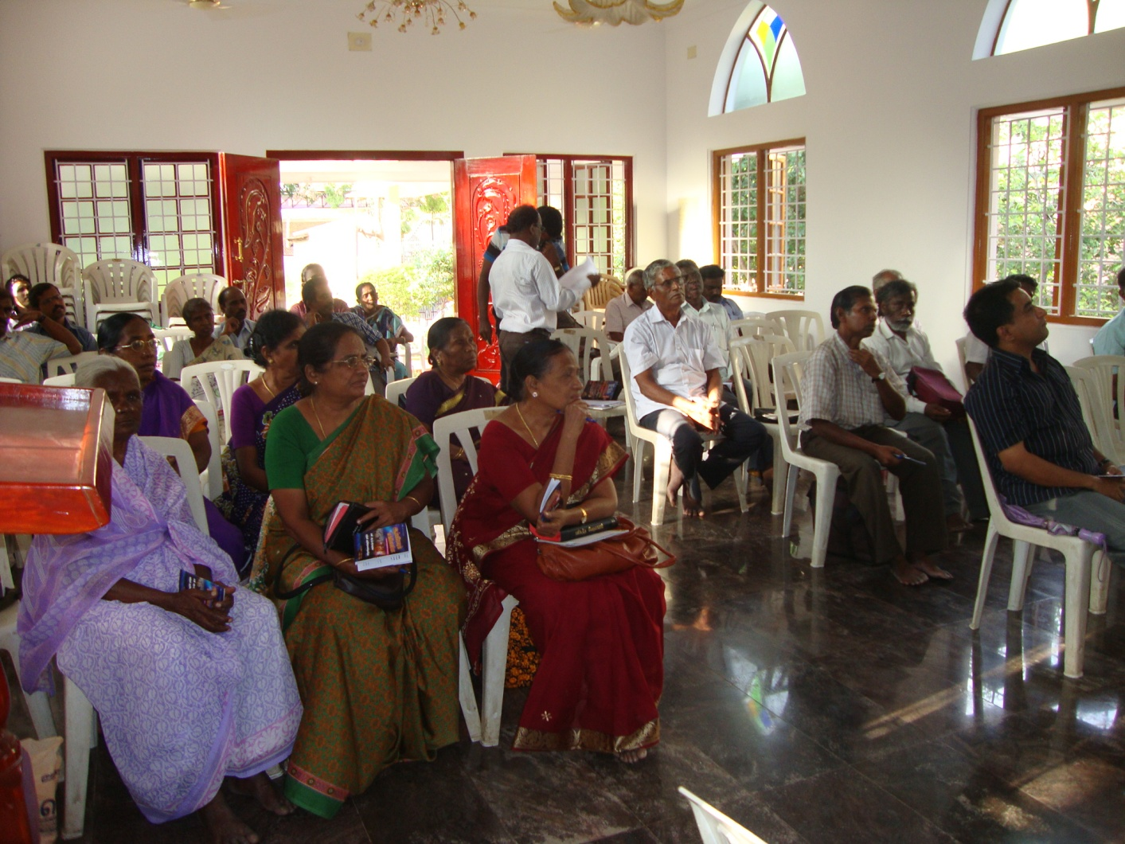
O.E– Erode (Oct 5 2013)

Slide 9
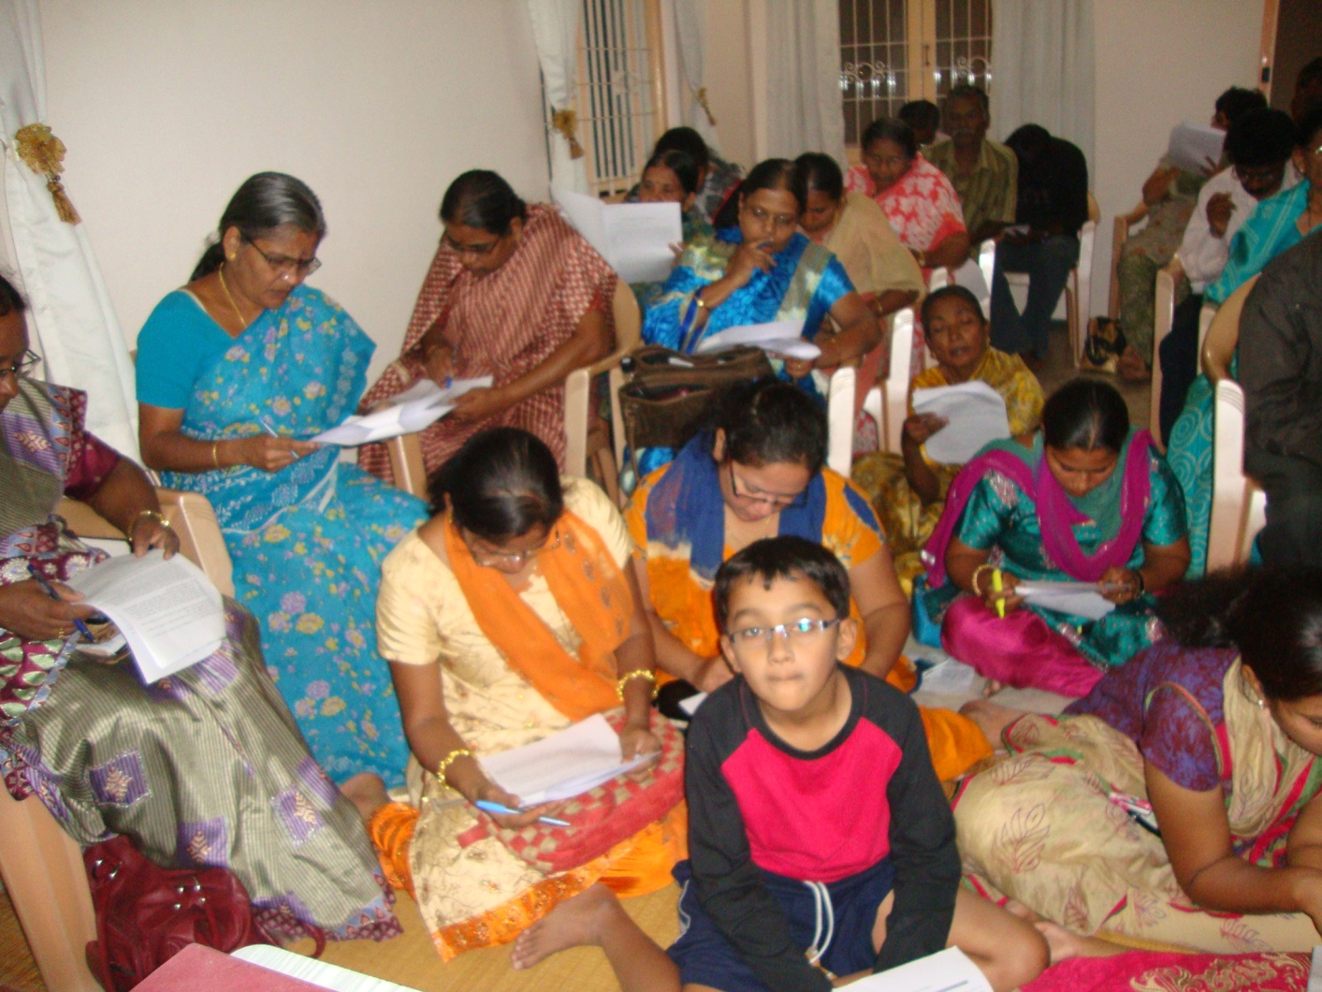
O.E– Thirupur (Oct 5 2013)

Slide 10
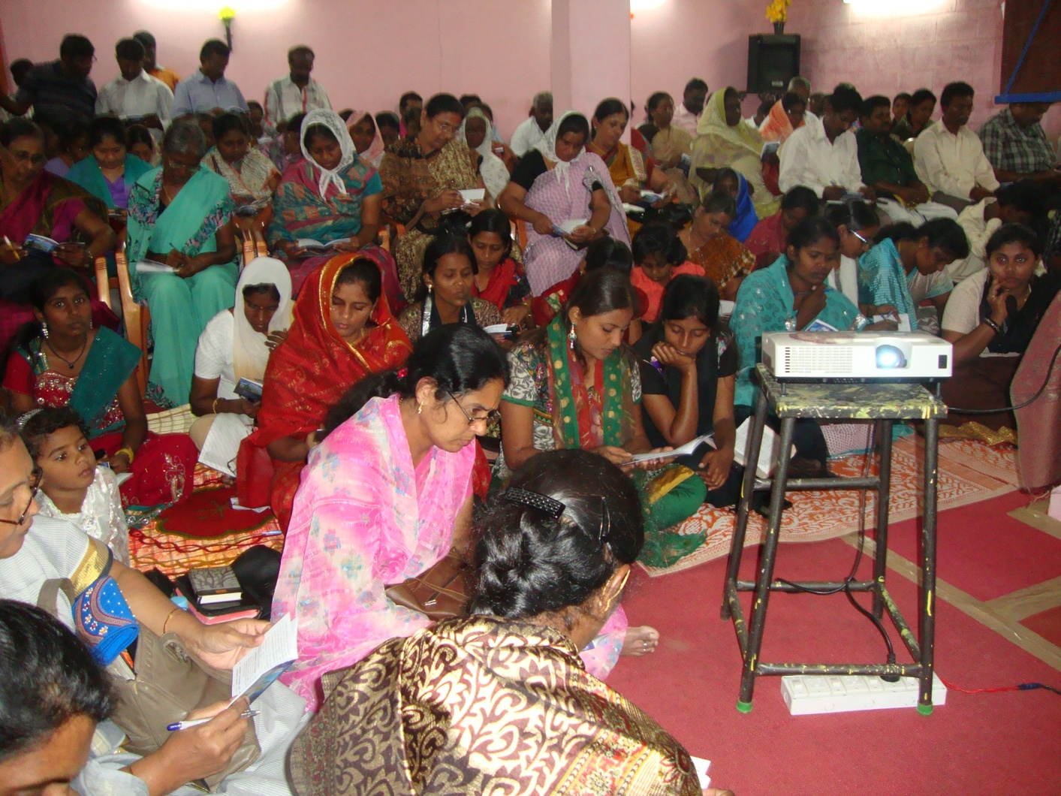
O.E– Cimbatore (Oct 6 2013)

Slide 11
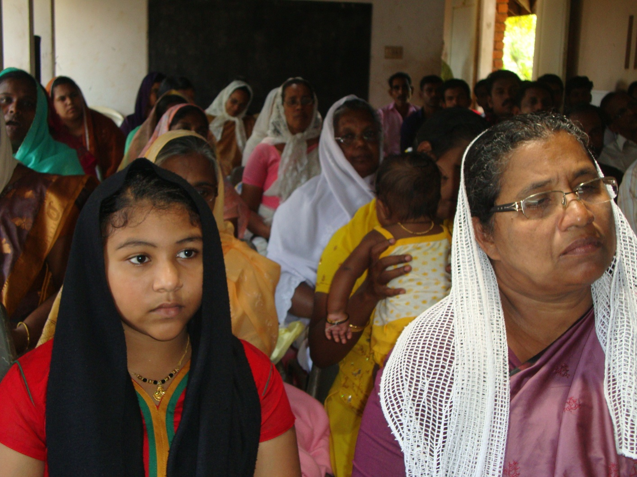
O.E– Thiruvananthapuram (Oct 7 2013)

Slide 12
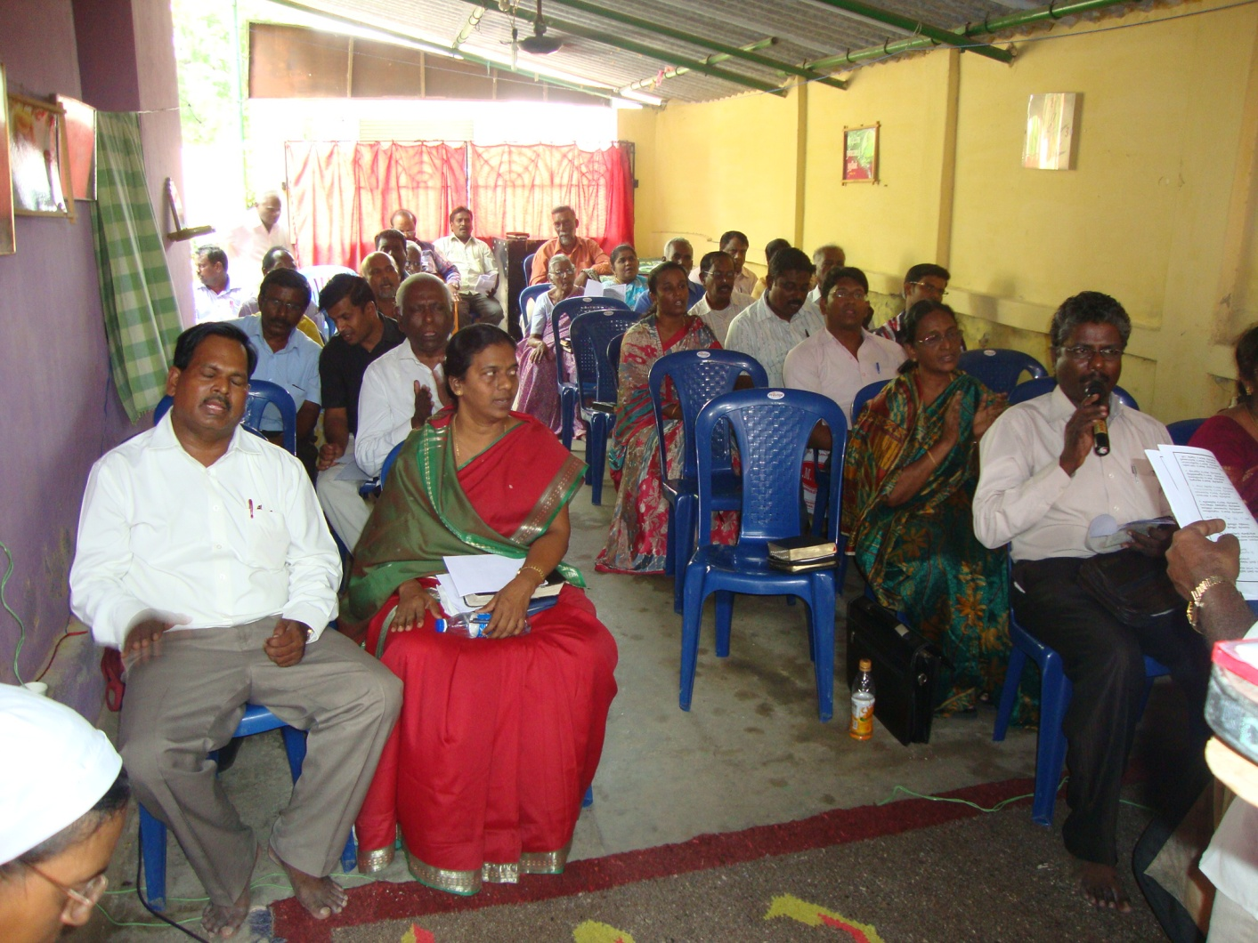
O.E– Ranipet (Oct 9 2013)

Slide 13
O.E– Ranipet (Oct 9 2013)

Slide 14
For 6 Districts,
Erode,
Namakal,
Karur,
Salem,
Coimbatore,
Tiruppur .
3000 expected..
And More..,

Slide 15
Sending OE through Mail, Facebook, Youtube
Received Positive Reply from
USA
UK
France
Uganda (Africa)
Central Republic of Africa
Meerut - UP
Dehradun – Uttaranchal
Mysore
Hyderabad
Kerala etc…

Slide 16
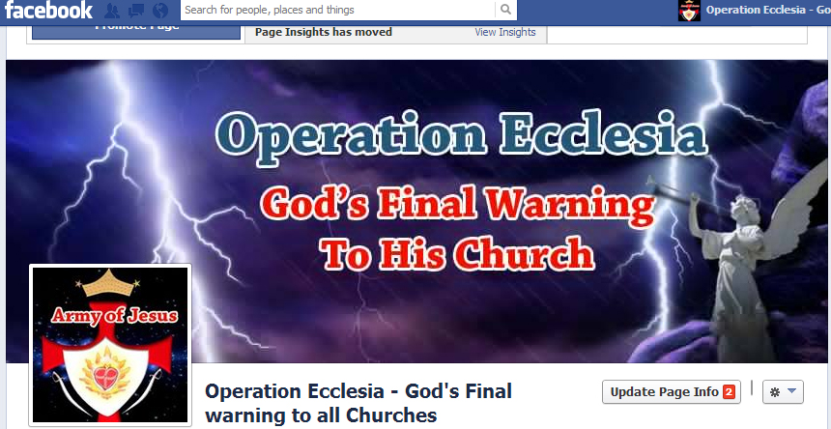
Facebook

Slide 17
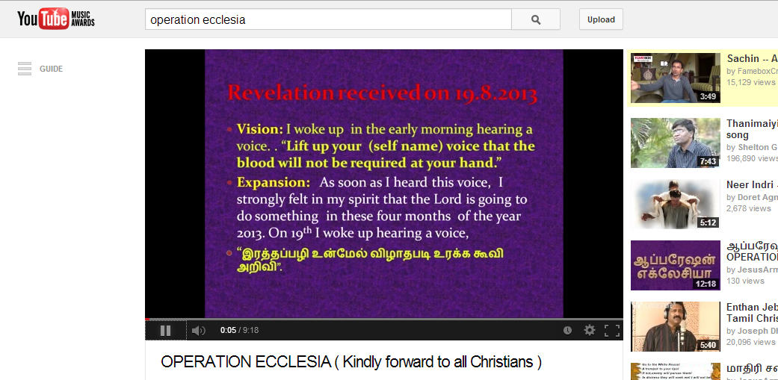
Youtube

Slide 18
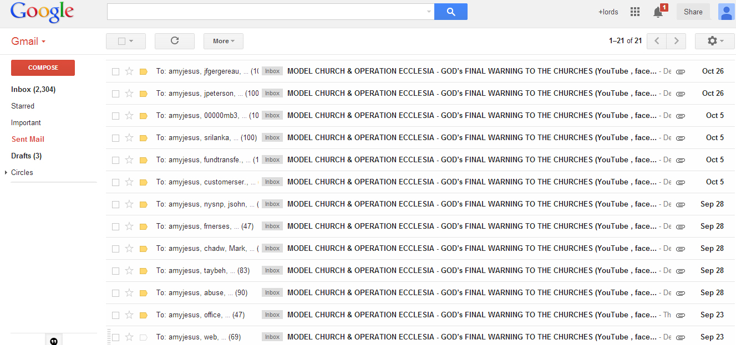
Gmail

Slide 19
Also Circulating through booklets
Translated in
Hindi
English
Malayalam
Bengali

Slide 20
Thank You

