Slide 1
Troop Church Evolution

Slide 2
17 years of Experiment with Troop Meetings – (1998-2014) Led to creation of “TROOP CHURCHES”

Slide 3
The Army of Jesus
November 11th
first troop of
The Army of Jesus
EI-Shaddai at Manaparai
by the 3 sisters

Slide 4
1998 – 2014 History
1998 – 2001 – Troops fast spreading & covering Tamil Nadu
R.C. bishops’ threat led to
Shekinah Aug 6, 2001 -2006
5 years of Shekinah - run by 100s of trained believer teachers
2006 June 16
Vision about INDIA & Model Church
Existence & fruitfulness of Institution Church challenged!
7 years 2006-2013 - Vision shared among the Churches in India
Various trainings as per the visions conducted .

Slide 5

Operation Ecclesia Revelation Aug 19, 2013
Vision : Restoration of the Church of Jesus Christ Acts 2:42-47
Goal: Bring back the present Church to its original status and love.
Vision
Unless church heads and leaders obey, God will hand over the Indian Church to the gentiles
Fulfillment
( BJP [May 26,2014] – Isa 19 :4

Slide 6
Converting troop meeting into TROOP CHURCH

Slide 7
Troop church revelations
* The Fall Of The Church ( Matt 21:19 – Fig Tree , Isa 5:1 to
6 – Vineyard ) Received on July 6, 2014
Paved the way to the preparatory meetings for starting the Troop Church
July 6, 2014 – Name Troop Meeting Changed to Troop Church at Mount Rephidim, Padappai

Slide 8
Troop Church
2 days Orientation given for 40 members on 19.7.2014 & 3.8.2014
Existing Church - New Model Church (Troop Church)
Pyramid structure of the Institutional hierarchical Church
Fall of the Church, etc …
Launching day fixed 6.8.2014

Slide 9
First Troop Church Rehoboth
Launched on : 6.8.2014
Leader : Bro. Daniel Paul
Place : David Nagar,
Padappai, CHENNAI

Slide 10
Started on August 6th 2014
Continued every Sunday
05.00 PM – 07.00 PM
Ended on
October 06th 2014
Troop
Rehoboth
Members List
Bro. Daniel Paul
Sis. Hema daniel
Sis. Arockiya Mary
Bro. Felix
Sis. Swapna
Bro. Immanuel
Bro. Kirubakaran
Bro. Judah Paul
Sis. Angelica
Sis Leema Rose
First Troop Church

Slide 11
Troop Rehoboth, divided into 6 Troops at Padappai on 13.10.2014
Rehoboth
John The Baptist Troop
Bro. Felix
Grace Troop
Sis. Angelica
Samuel Troop
Sis. Swapna
Jehovah Nissi Troop Bro. Judah
Miracle Troop
Bro. Paul Daniel
Jehovah Rapha Troop
Bro. Immanuel

Slide 12
Tamil Nadu Model

Slide 13
Revealed to Troop Church David, Porur Strategy for Oct / Nov / Dec -2015
15 Troop Churches in the identified locations of the City by 31st Dec 2015
15 leaders will join hands together & build the troop churches in Chennai
Frequent leaders meet- next 03 months

Slide 14
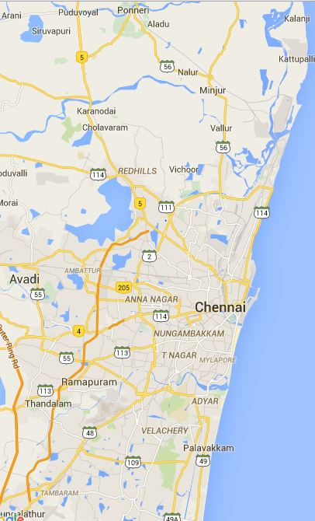

LH Ponneri – Daniel
Troop Ruth
Troop Samuel
LH Kolathur – Grace
LH Kolathur – Yahweh
Troop Madhura Gandham
LH Perambur – Yezhumbi Prahasi
Troop Yehowah rapha
LH Ayapakkam – Jehovah Yierah
LH Anna Nager – The Rock
LH Kodambakkam – Elshadai
LH Virugambakkam – Jehovah Yierah
Troop Bethel
LH Thiruvanmiyur – Triune God
Troop Ruth
LH Porur – David
Troop Vallamai
LH Keelkattalai – John The Baptist
Troop Church
LH Palavakkam – Conqueror
LH Crompet – Good Shepard
LH OMR – Helkiah
LH Tambaram – Grace
Troop Shalom
LH Panayur – Shiloam

Slide 15
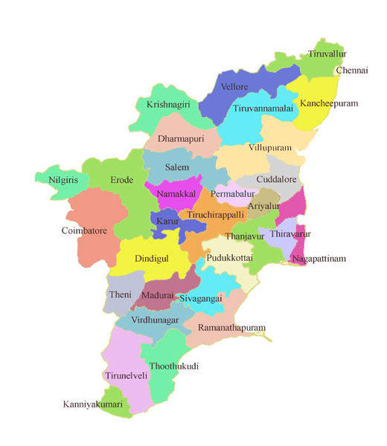
Chennai Model translated toTamil Nadu in the next 4 months(6.8.2016)
Light House s in Thiruvallur
Light House s in Chennai
Light House Vellore– Deborah
Light House Krishnagiri– Grace Rehaboth
Light House s in Kancheepuram
Light House s - Dharmapuri
Light House Salem
Light House Erode
Light House Namakkal
Light House Karur
Light House Dindigul - Royal Family of Jesus
Light House Madurai - David
Light House Theni - Caleb
Light House Ramanadhapuram – Good Samaritan
Light House Virudhunager– Shadrach
Light House Kanniyakumari – Hepseba
Light House Tuticorin– Joshua

Slide 16
LH Ponneri – Daniel
Troop Ruth
Troop Samuel
LH Kolathur – Grace
Troop Tandiarpet
LH Kolathur – Yahweh
Troop Fragrance of Christ
LH Perambur – Yezhumbi Prahasi
Troop Yehowah rapha
LH Ayapakkam – Jehovah Yierah
Troop Antioc h Avadi
LH Anna Nager – The Rock
Troop Good Shephard
LH Kodambakkam – Elshadai
LH Virugambakkam – Jehovah Yierah
Troop Bethel
LH Thiruvanmiyur – Triune God
Troop Ruth
LH Porur – David
Troop Vallamai
Troop Paul
Salt of The Earth
LH Keelkattalai – John The Baptist
Troop Job
LH Palavakkam – Concuror
LH Crompet – Good Shepard
LH OMR – Helkiah
Troop Shalom
LH Tambaram – Grace
Troop Mudichur
LH Panayur – Shiloam

Slide 17
Persistent efforts of the AOJ Soldiers
32 Light Houses
latest by 30th April 2016

Slide 18
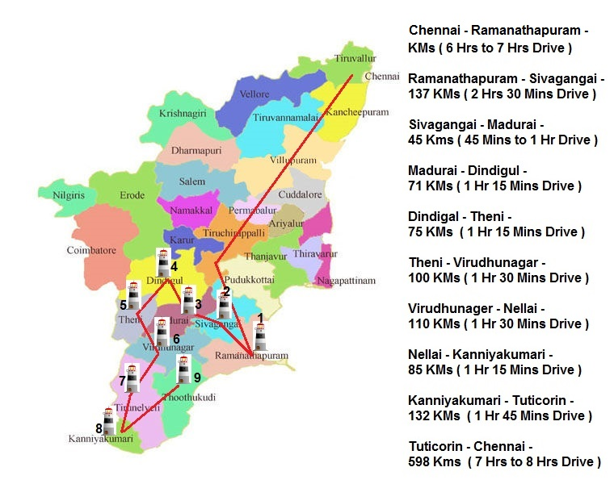
9 Districts covered in 2days (1 Week end)
April 15,16,17 2016

Slide 19
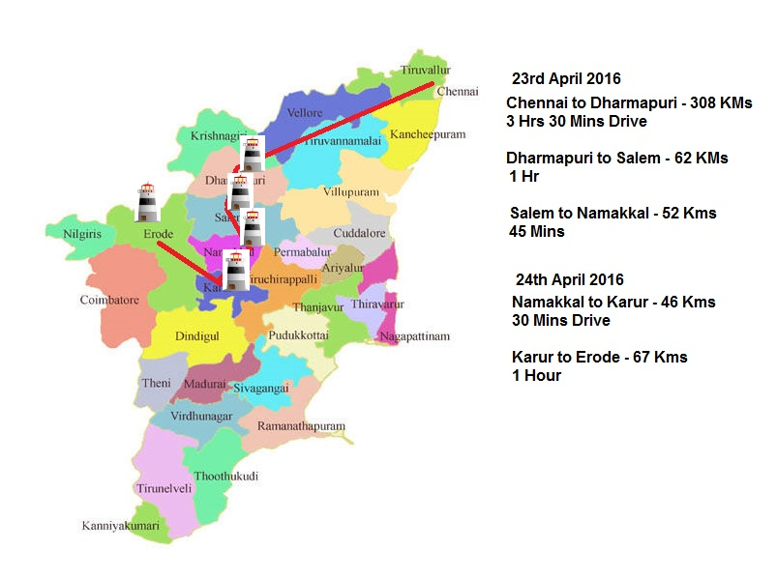
5 Districts covered in 2days (next Week end)
April 23, 24, 2016

Slide 20


Jehovah Shama
Jesus Commandos
City on the Hill
Ruth - Leethiyal
Kingdom Of Jesus
Smyrna
Jesus War Brigade
Lord’s Heavenly Army
Lion Of Judah
The Acts
First Fruits
Light of the world
River of the Living Water
Prayer Warrior
Grace Of Jesus
Abundant Life in Jesus Christ

Slide 21
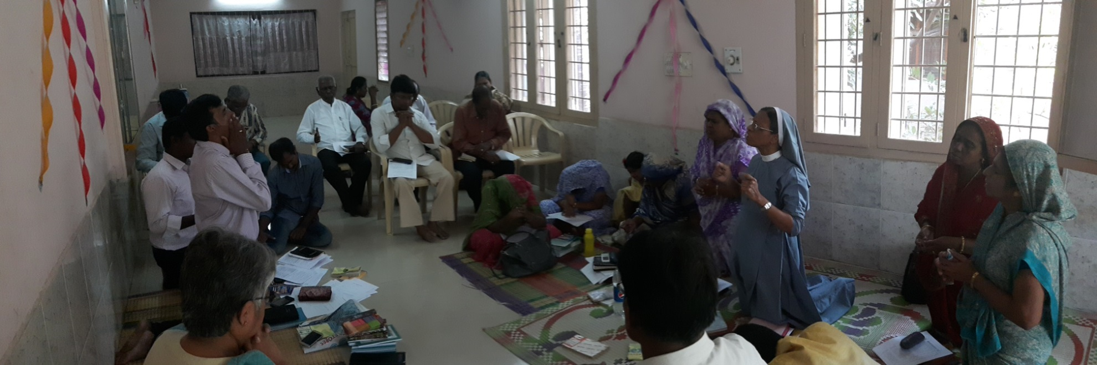
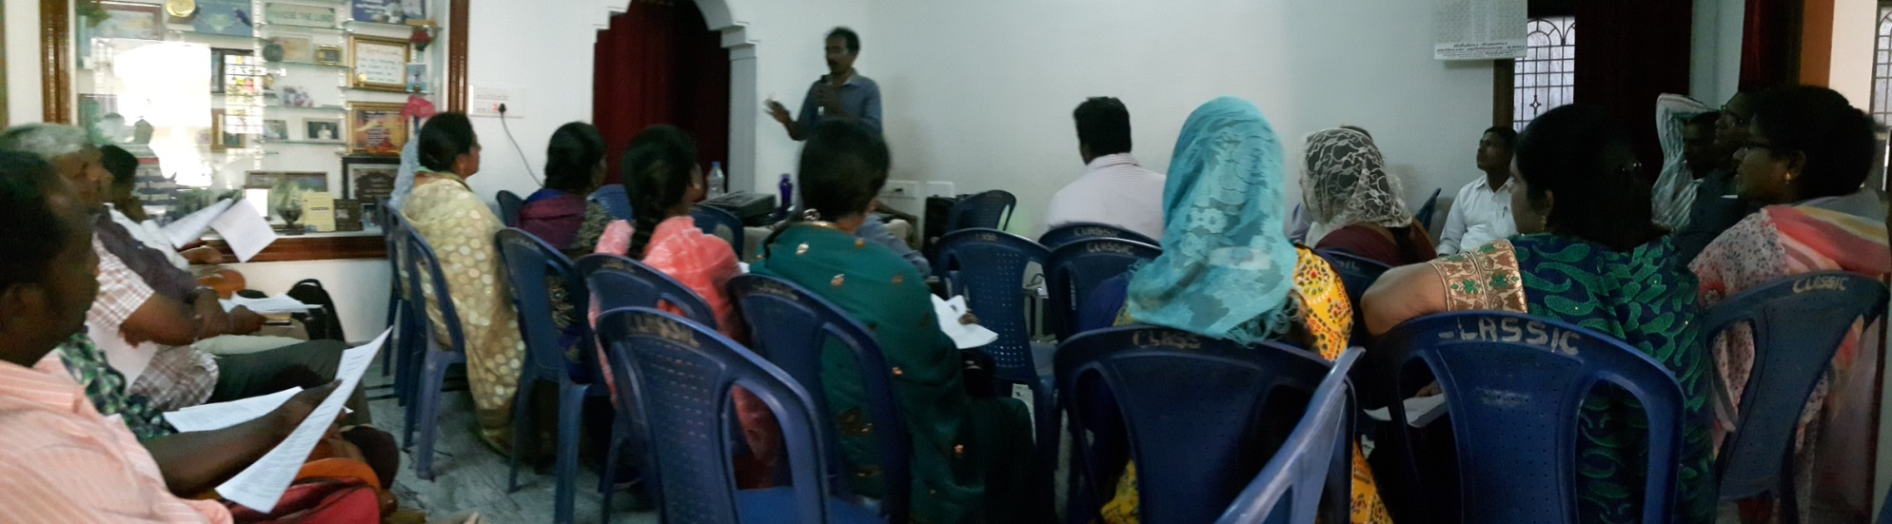
Light House Launch @ Vellore
Light House Launch @ Krishnagiri

Slide 22
Troop church training (TCT) Conducted
Batch No | Name of the Place conducted | Date
1 | Padappai | July 19th 2014
2 | Padappai | Aug 3, 2014
3 | Tiruppur | Nov 17, 2014
4 | ISS, Delhi | Nov 22 & 23 2014
5 | Padappai | Dec 7, 2014
6 | Udumalpet | Dec 20, 2014
7 | Madurai | Dec 27, 28 & 29
8 | Salem | Dec 30,31
9 | Kottayam. Kerala | Jan 11, 2015
10 | Delhi | Jan 21 , 2015
11 | Hyderabad | Jan 28 , 2015
12 | Maripeda, Warangal, A.P. | Jan 29 , 2015
13 | Adyar | Jan 30
14 | Vellore | Jan 31 , Feb 1
15 | Pondicherry | Feb 4
16 | Trichy | Feb 7
17 | Perambur | Feb 12
18 | Madurai | Feb 14
19 | Palavakkam | Feb 16
20 | Thiruvannamalai | Feb 17

Slide 23
Troop church training (TCT) Conducted
21 | Padappai | Feb 18
22 | Pondy | Feb 19
23 | Mumbai | Feb 24
24 | Pune | Feb 25
25 | Bangalore | Mar 1
26 | Shillong | Mar 5 – 9
27 | Veerampatinam , Pondy | Mar 12
28 | Kozhikode | Mar 14
29 | Vayanad | Mar 16
30 | Perumbavur | Mar 17
31 | Ernakulam | Mar 18
32 | Thiruvalla | Mar 20
33 | Trivandrum | Mar 21
34 | Marthandam | Mar 23
35 | Nagercoil | Mar 24
36 | Kanyakumari | Mar 25
37 | Porur , Chennai | Mar 29
38 | Kandamal , Orissa | Mar 30 – Apr 3
39 | Jagdalpur | April 4 , 5
40 | Raipur | Apr 6

Slide 24
41 | Birmitrapur ( APT & TCT ) | Apr 9
42 | Ranchi | Apr 10 , 11
43 | Belurmath , Howrah | Apr 12
44 | Howrah, West Bengal, | Apr 13
45 | Varanasi, U.P. | Apr 14
46 | Sathya Nagar - Pondicherry | Apr 17
47 | Gr. Noida, U.P. | Apr 20
48 | Bareilly | Apr 21
49 | Chidambaram | May 15
50 | Trichy - | May 17
51 | Kanagachetty Kulam , Pondy | May 23
52 | Siliguri | May 25
53 | Sikkim | May 27
54 | Goa | May 31
55 | Pondy | June 6
56 | Srinagar | June 17
57 | Anantag ( Dr Paul’s House) | June 18
58 | Srinagar ( Pr Sudhakar’s house ) | June 19
59 | Gwalior | June 22
60 | Nepal

Slide 25
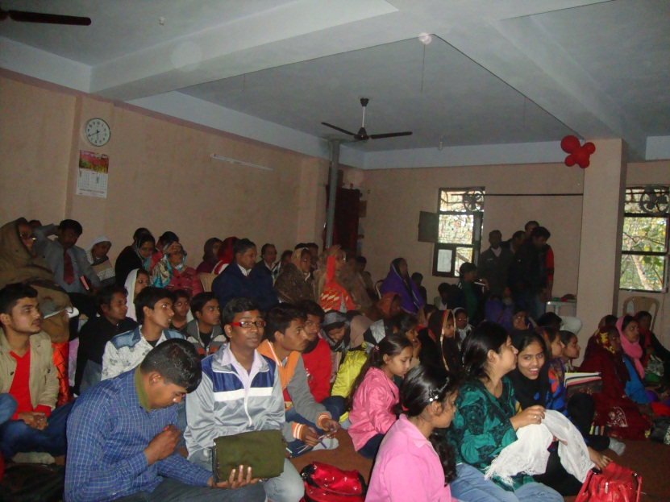
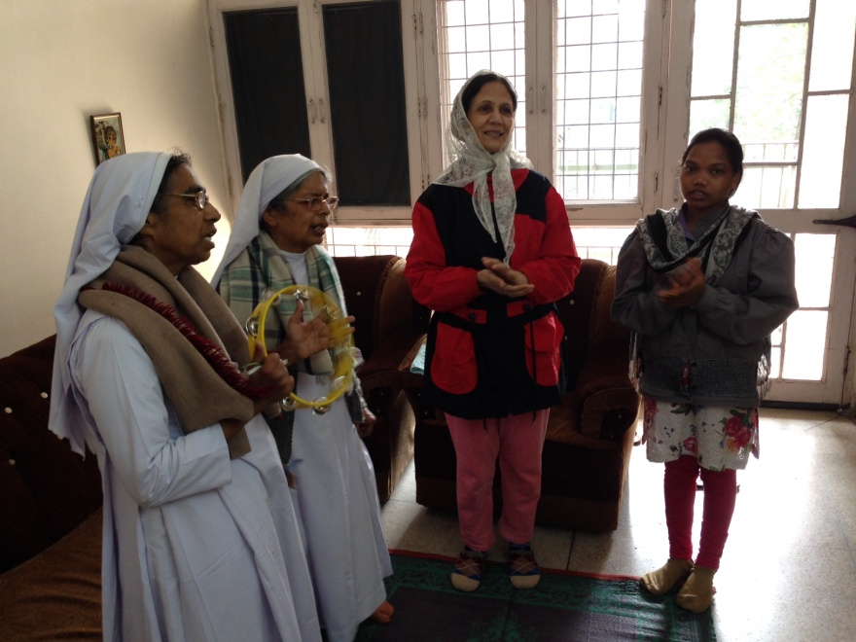
TCT strategy taken from Kanya Kumari to Srinagar, Kashmir
Delhi, Rohini TCT
Started on 05/02/2015
Sunday 9:00 – 11:00 a.m.
Salvation Troop

Slide 26
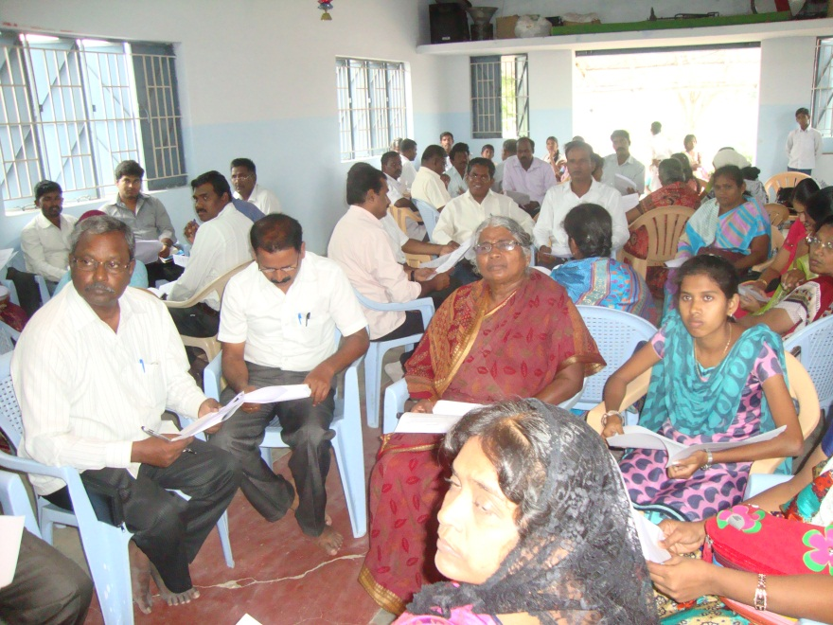
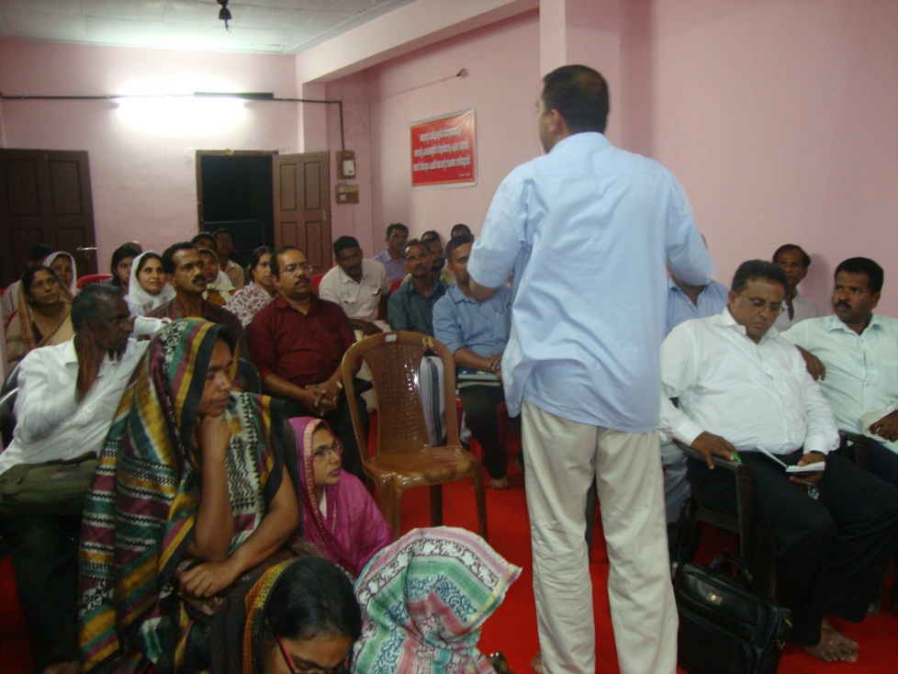
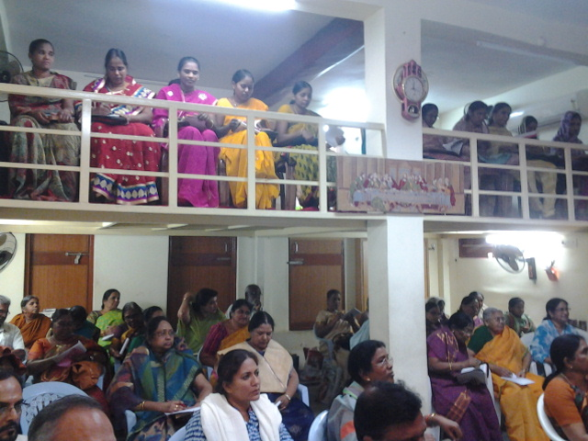
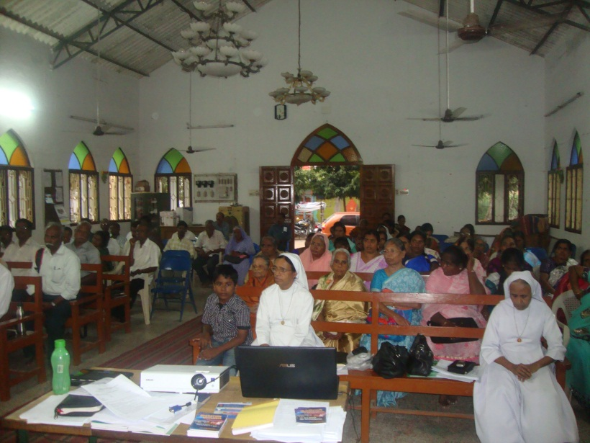
Udumalpet & Tiruppur 19,20 Dec 2014
Kottayam, Kerala Jan 11, 2015
Hyderabad, Jan 28, 2015
Pondy, Feb 4, 2015

Slide 27
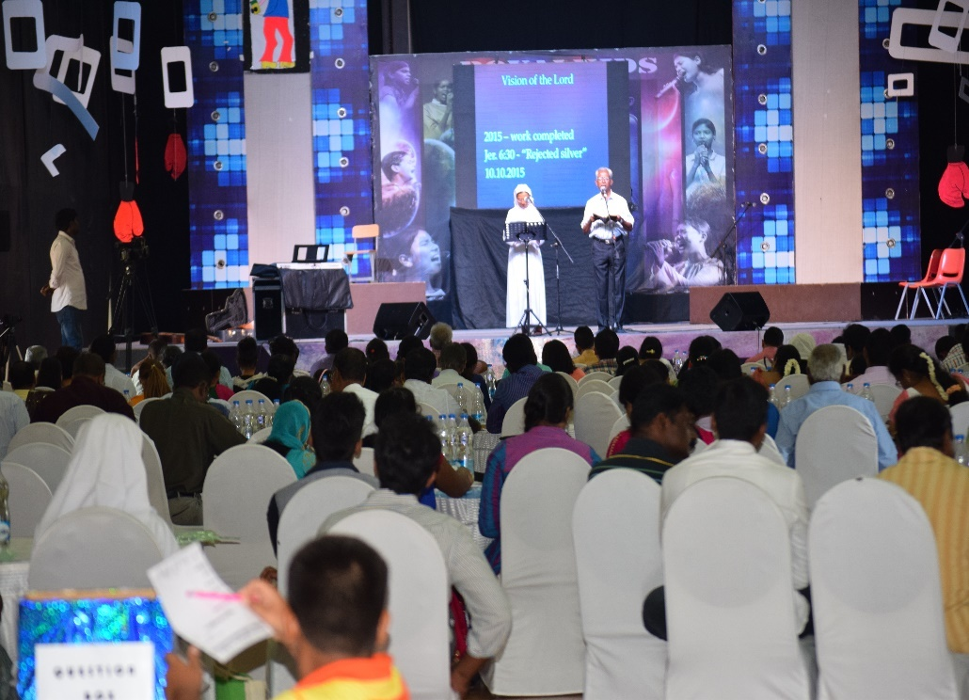
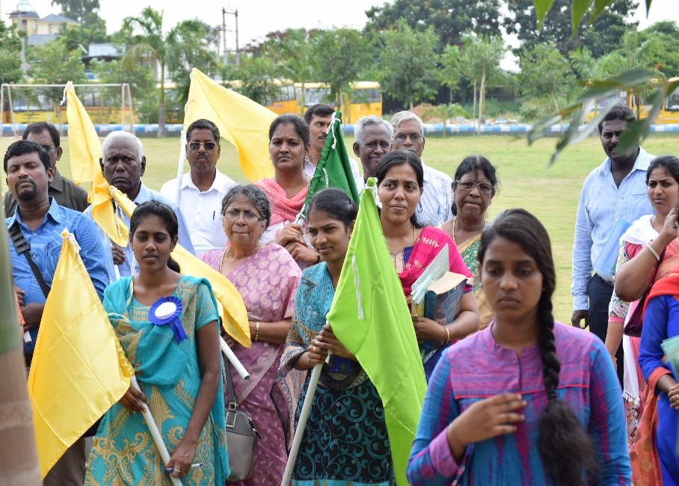
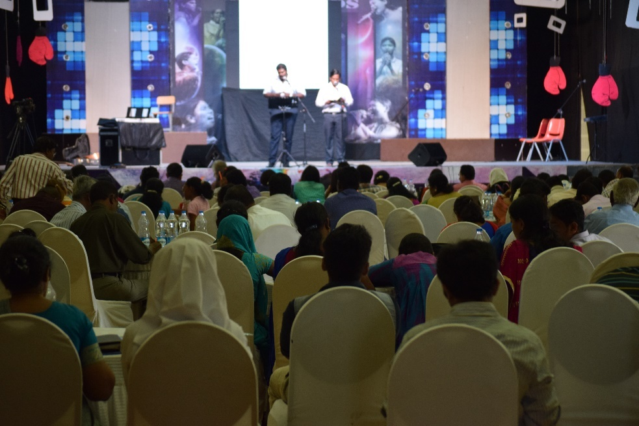
National Light House Conference 2016

Slide 28
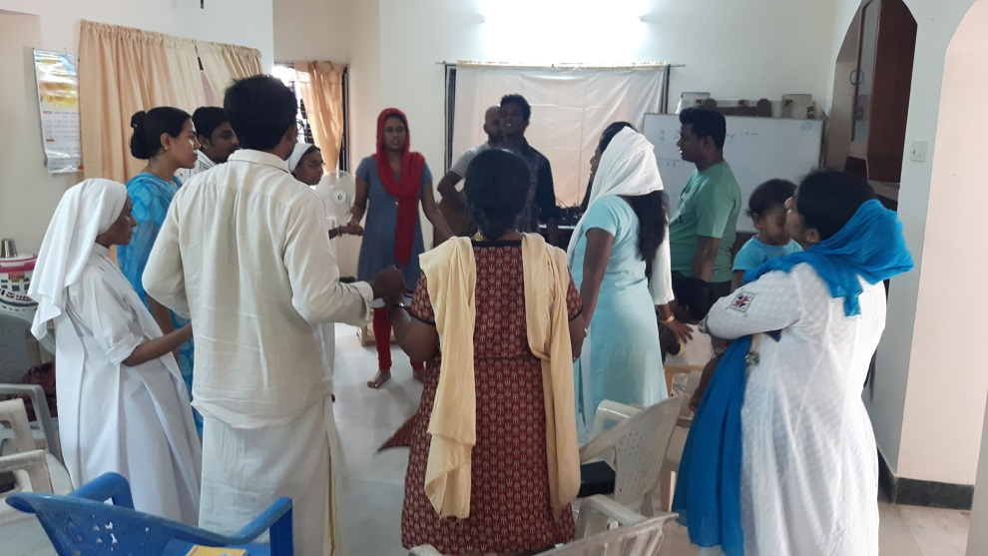
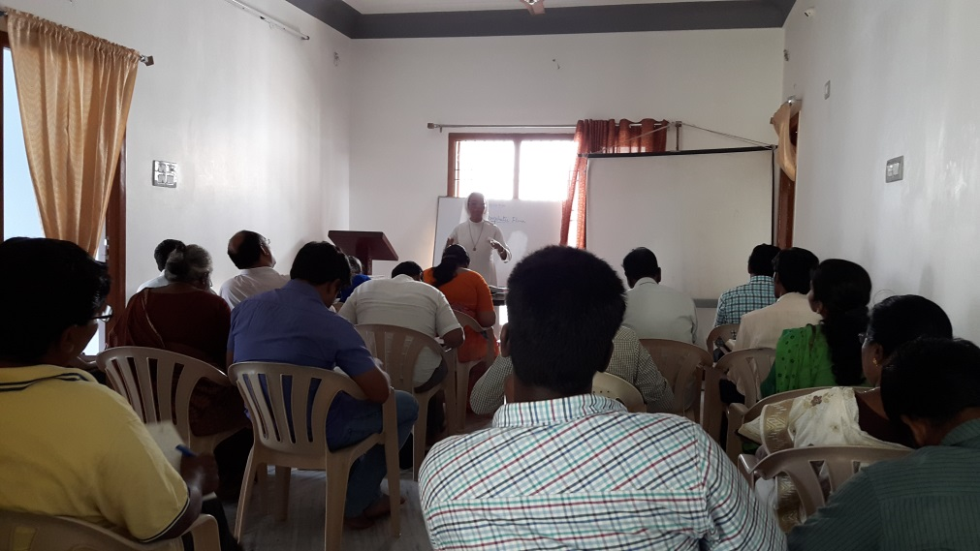
GIFTS SCHOOLS STARTED in 2016
School of Worship
School of Prophecy

Slide 29
TC 200Chennai
On 4.10.2017 - Command from the Lord
Chennai should be filled with Troop Churches.
Chennai Corporation -15 zones taken. Map –zonewise - prepared for planting TCs
Going round Chennai, prophesying to the dry bones & start troops all over Chennai

Slide 30
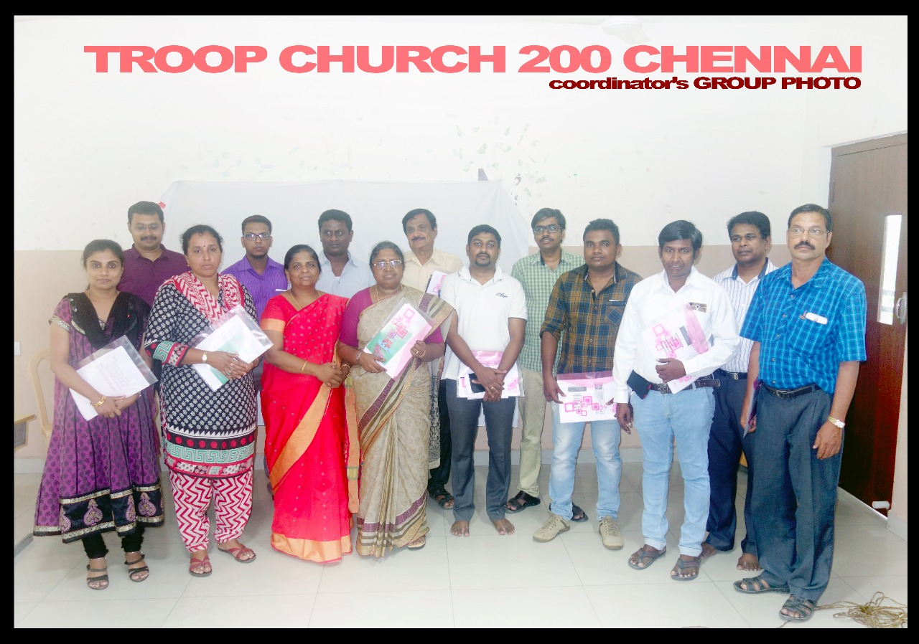
TC 200 Meet at Gateway School
15 coordinators were appointed in charge of all the 15 Zones
They were entrusted duties of 200 wards, opening TCs in all 200 wards of Chennai City

Slide 31
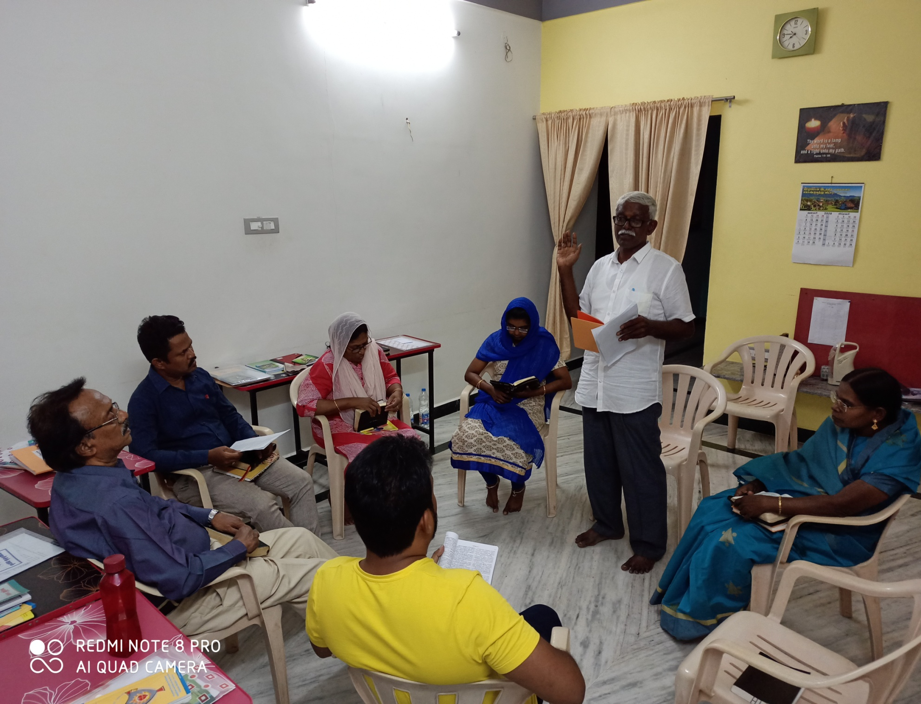
15 Zones 15 Zonal coordinators Took up the work of starting 200 TCs in 200 wards In 15 Zones

Slide 32
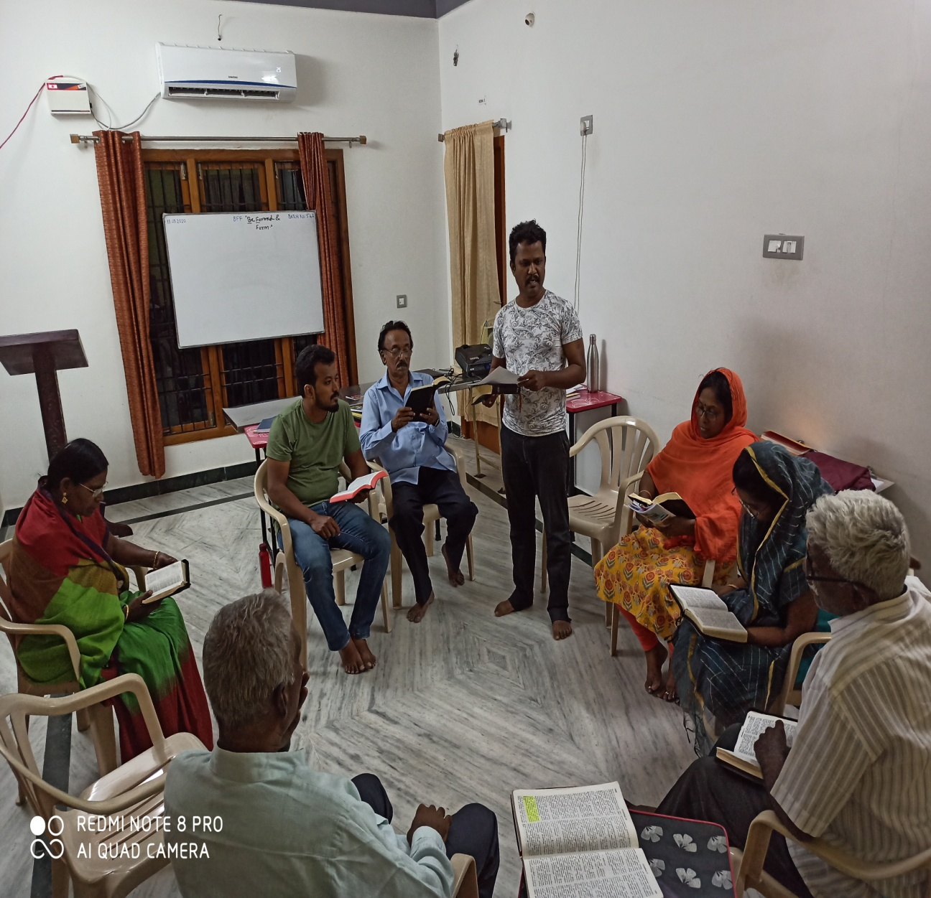
Duties of a soldier
The Individual Soldier will
Set apart a specific period of time for personal prayer ( 2 1/2 hours a day) (Mk. 3:13)
2. Weekly once Troop Church Meets
3. Share Gospel with 2 persons daily
4. Start a new Troop Church every 2 months

Slide 33
TROOP CHURCH FORMATION
There should be ten soldiers in a troop
The troop will be known by a biblical name.
3. Troop leader is one who leads a troop of 10 soldiers.
Soldiers of the respective Troop will assemble together in a particular house at a particular time once a week.
The troop gets dispersed after each soldier starts a new troop within a period of 2 months

Slide 34


Slide 35
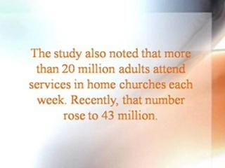

Slide 36

IS
YOUR
CHURCH
BIBLICAL ?

Slide 37
The characteristics of a Troop Church
1. Troop Church raises leaders, shepherds, prophets, counselors and all other fivefold ministry workers.
2. It has no permanent visible leader or strict visible structure
3. It has no office, no full timer, no paid worker etc.
4. No organizational (hierarchical) set up.
6. No money collection or transaction.
7. No election, board, Committee etc.

Slide 38
The characteristics of a Troop Church
8. Each Troop is Church independent in nature.
9. Every Troop Church trains up believers in their spiritual gifts like worshipping, preaching, prophecy etc.
10. Since the mother troop disperses after 2 months, there is no stagnation of ministry gifts.
10. No pollution or corruption with money or power
11. Each Troop multiplies into 2,3, even 10 fold after 2 months.
11. The two wings of Troop Church are Decentralization and Multiplication .
After getting multiplied, once in a while (after 2 or 3 months) the Mother Troop Church members and all its branches soldiers come together for a Fellowship to share their joy in the Lord.

Slide 39
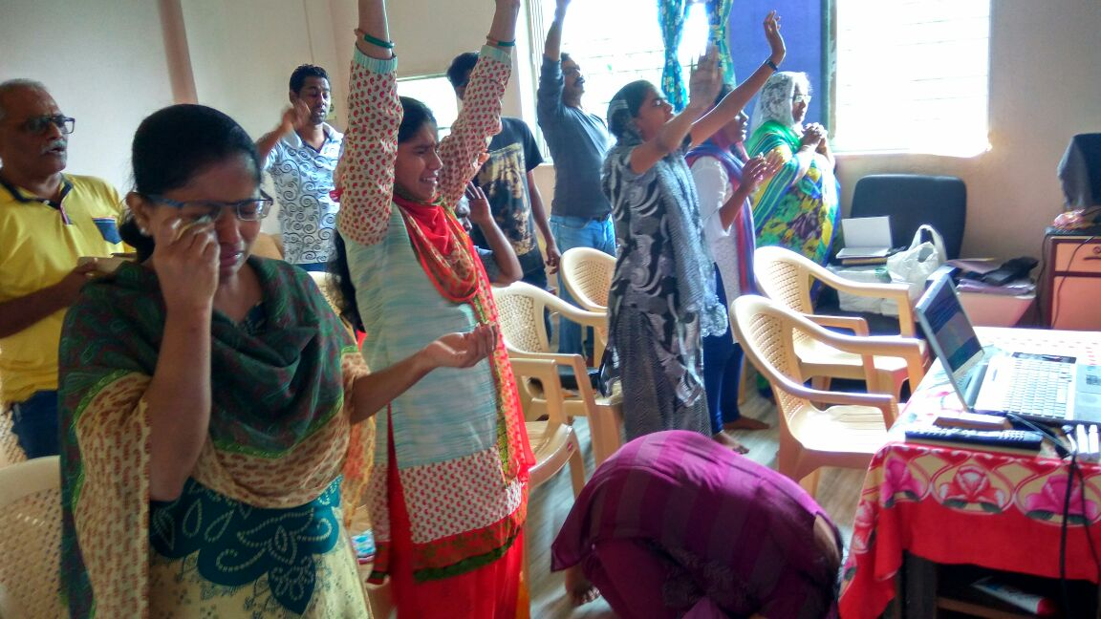
Troop Church Equips believers for Ministry through BFF, Gift schools
Teach Them
Show Them
Coach Them
Equip Them
Anoint them
Release Them
Eph 4:11-14

Slide 40
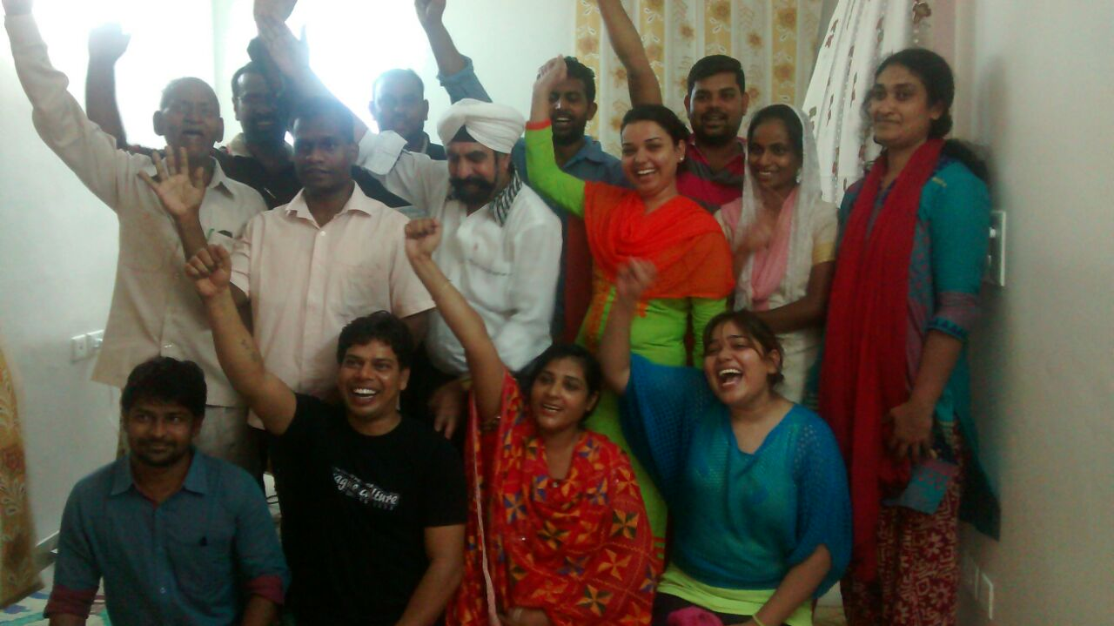
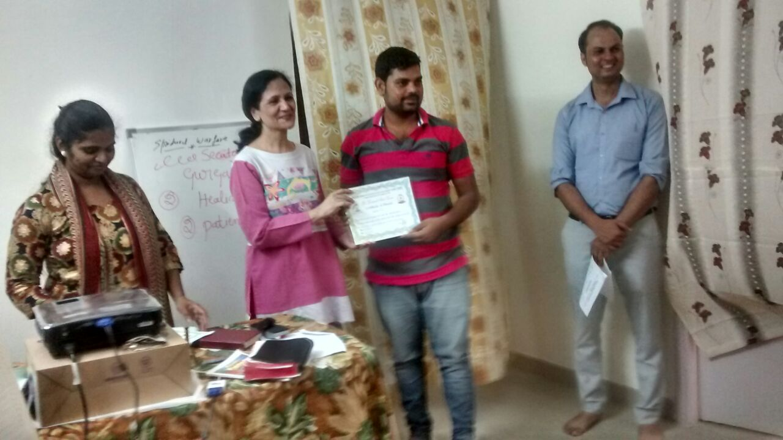
Be Formed & Form Delhi

Slide 41
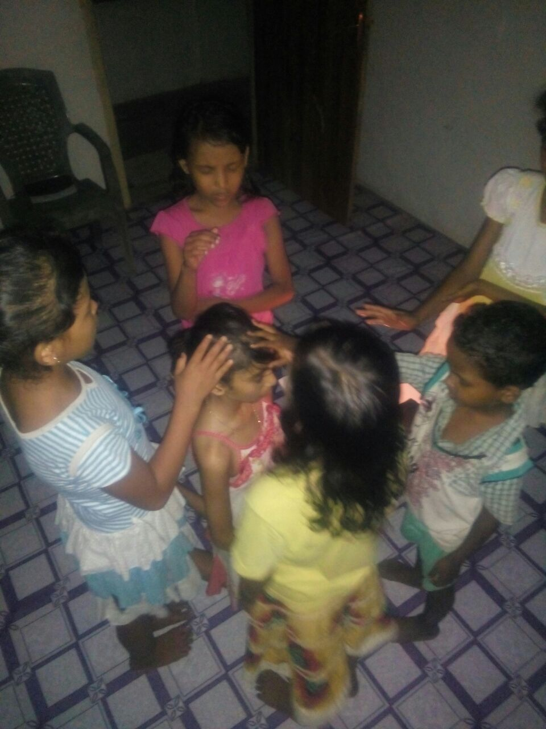
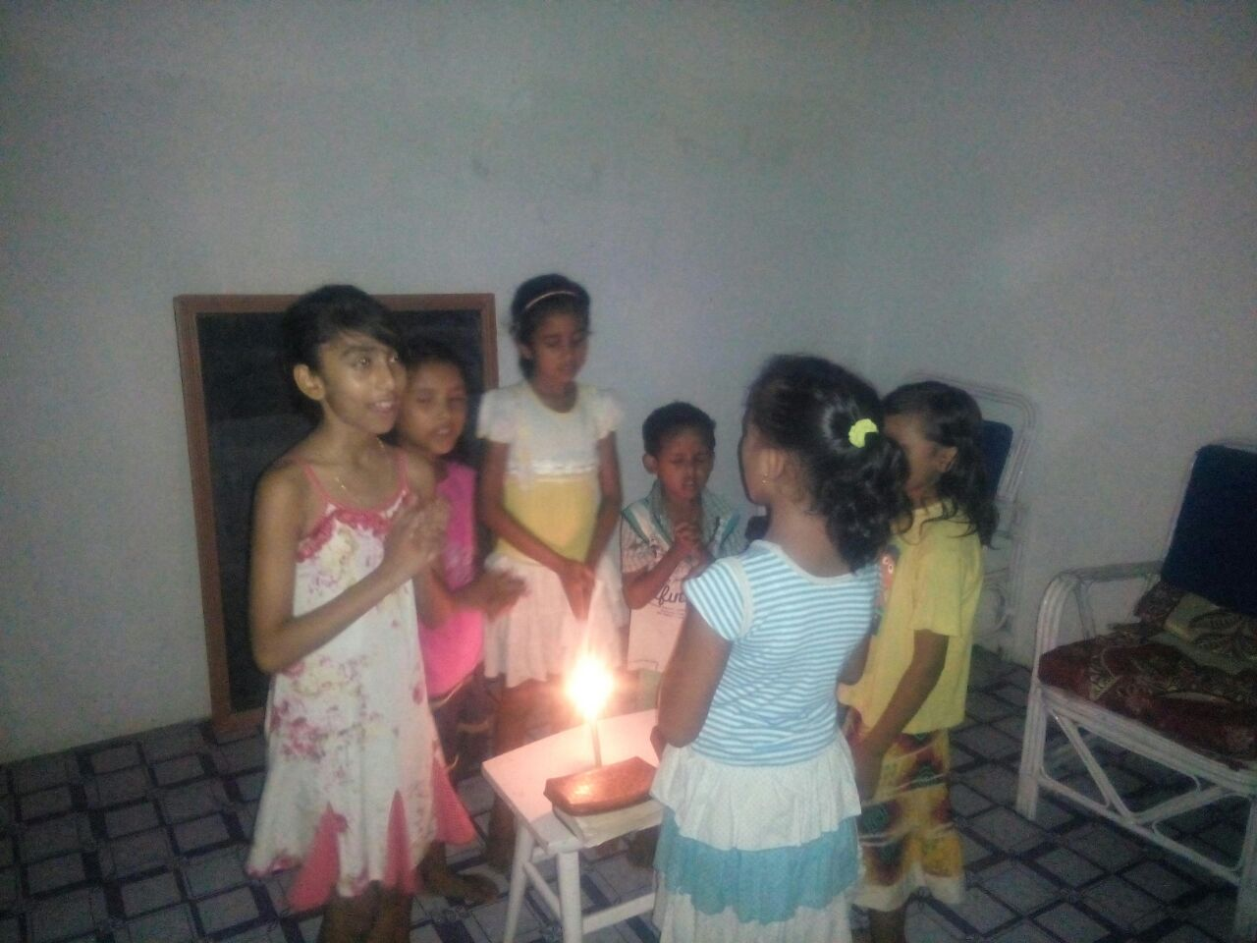
Children Troops, Assam

Slide 42
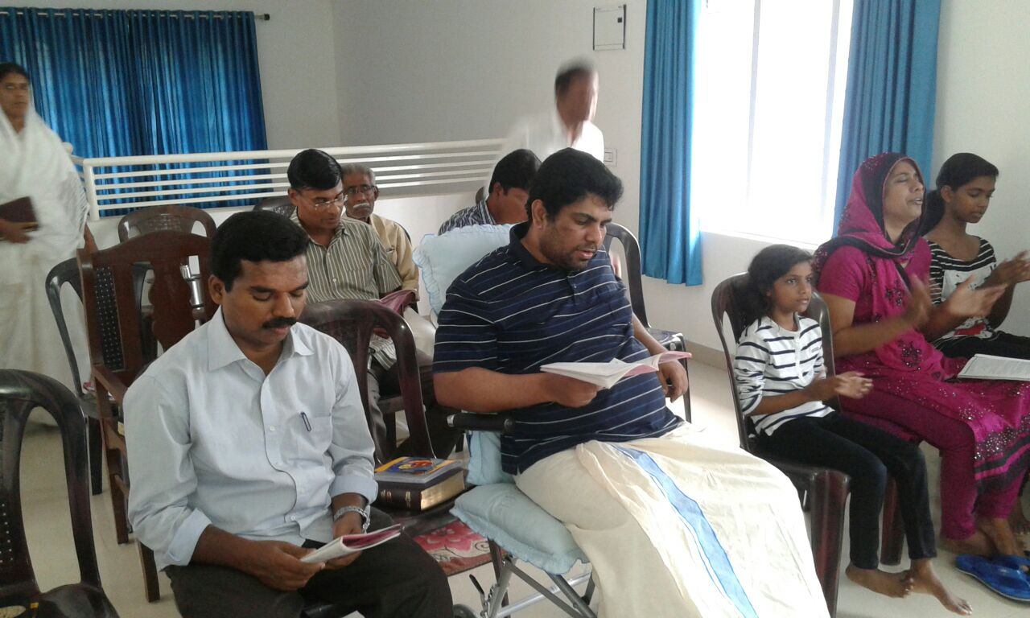
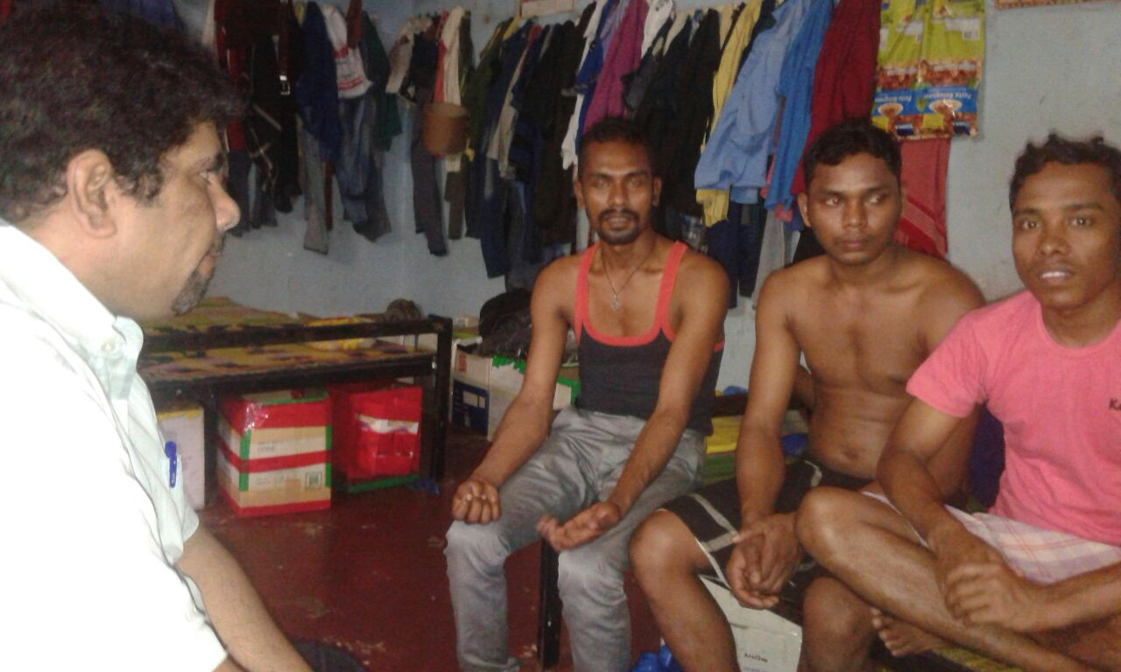
BFF in Kerala & Troop Church among N.Indians

Slide 43

TRAINING ON

Slide 44

1. Welcome & Conducting 2 min 2. OPENING PRAYER 2 min 3. PLEDGE (2 Cor 10:3-5) 3 min. 4. PRAISE AND WORSHIP 20 min. 5. MESSAGE 30 min. 6. INTERCESSORY PRAYER 20 min. 7. Testimony 20 min 8. DISCUSSION & planning 18 min. 9. CLOSING PRAYER & Ps 144 : 1 3 min. 10. Report Pre. & sending 2 min.
TROOP CHURCH

